Slide 1


DEPARTMENT OF ELECTRONICS AND COMMUNICATION ENGINEERING
18ECP105L-MINOR PROJECT- III
FINAL REVIEW
Automatic Distilled Water Monitoring and Refilling System Using Machine Learning Algorithm
GUIDED BY,
Mrs.D.PUSHPALATHA m.e.,
ASSISTANT PROFESSOR
PRESENTED BY:
AANADHAKRISHNAN.S(927622BEC001)
AKASH.B(927622BEC007)
CHANDEESH.S.S(927622BEC025)
CHIRADEEP.P(927622BEC026)
YEAR/SEMESTER-III/V
BATCH NUMBER: 05
DATE: 02.11.2024

Slide 2
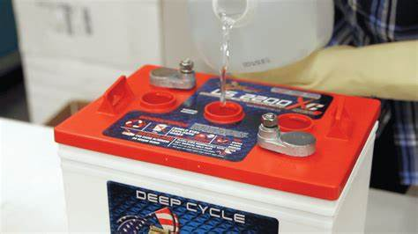
OBJECTIVES
The objective of the project is to design and develop an automated system that monitors and maintains optimal water levels in batteries using a pressure-based depth sensor. The system refills the battery automatically when the water level is low, with real-time alerts sent via SMS using a GSM module. This reduces manual intervention, enhances battery performance, and ensures efficient water management for various applications.

Slide 3
ABSTRACT
This project introduces an Automatic Distilled Water Monitoring and Refilling System to ensure uninterrupted water supply in battery-powered systems, thereby enhancing their performance and lifespan. The system uses a pressure-based depth sensor to continuously monitor water levels within the battery and triggers an automated refilling mechanism when the level falls below a predefined threshold. The refilling mechanism draws water from an auxiliary distilled water tank, ensuring precise and timely replenishment while eliminating the risks of overfilling or delays associated with manual intervention.
To further enhance reliability, the system also monitors the water level in the auxiliary tank, sending SMS notifications via a GSM or IoT-enabled module to alert users when the tank requires refilling. A microcontroller processes the sensor data and controls the refilling mechanism, while the modular hardware design supports scalability and customization. This automated solution minimizes manual effort, ensures operational efficiency, and provides real-time monitoring and alert capabilities, making it ideal for industrial, laboratory, and domestic battery systems.

Slide 4
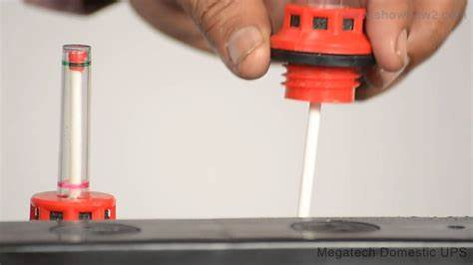
PROBLEM STATEMENT
A solution is needed that can automatically detect the reduction of water levels and alert users in real-time, ensuring timely maintenance and preventing system failure.

Slide 5
LITERATURE SURVAY
FEATURE | EXISTING SYSTEMS | PROPOSED SYSTEM
Monitoring Method | Manual monitoring, requiring regular human inspection. | Automated, real-time monitoring using IoT-based sensors.
Maintenance Scheduling | Based on periodic manual checks or after failure occurs. | Predictive maintenance using machine learning algorithms.
Cost Implications | Higher due to frequent maintenance and unexpected failures. | Lower long-term costs due to reduced maintenance and improved battery life.
Battery Life Impact | Reduced due to improper water level maintenance. | Optimized, ensuring proper water levels, extending battery life.

Slide 6
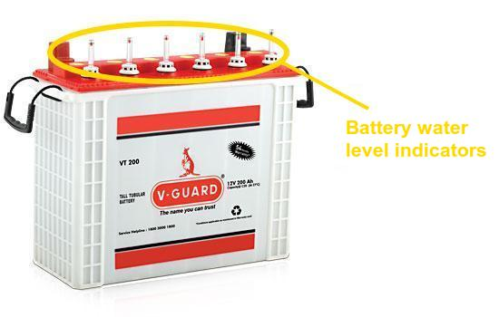
INTRODUCTION
Distilled water is critical for maintaining battery performance by ensuring proper electrolyte levels. Manual refilling is often labor-intensive, error-prone, and inefficient, leading to potential battery damage and higher costs.
This project proposes an automatic distilled water monitoring and refilling system using a depth sensor for precise water level detection. The system automatically refills the battery from an auxiliary distilled water tank when levels are low and monitors the auxiliary tank to send SMS alerts when it requires refilling.
This solution streamlines water management, reduces manual effort, and enhances battery lifespan, making it ideal for industries, laboratories, and domestic use.

Slide 7
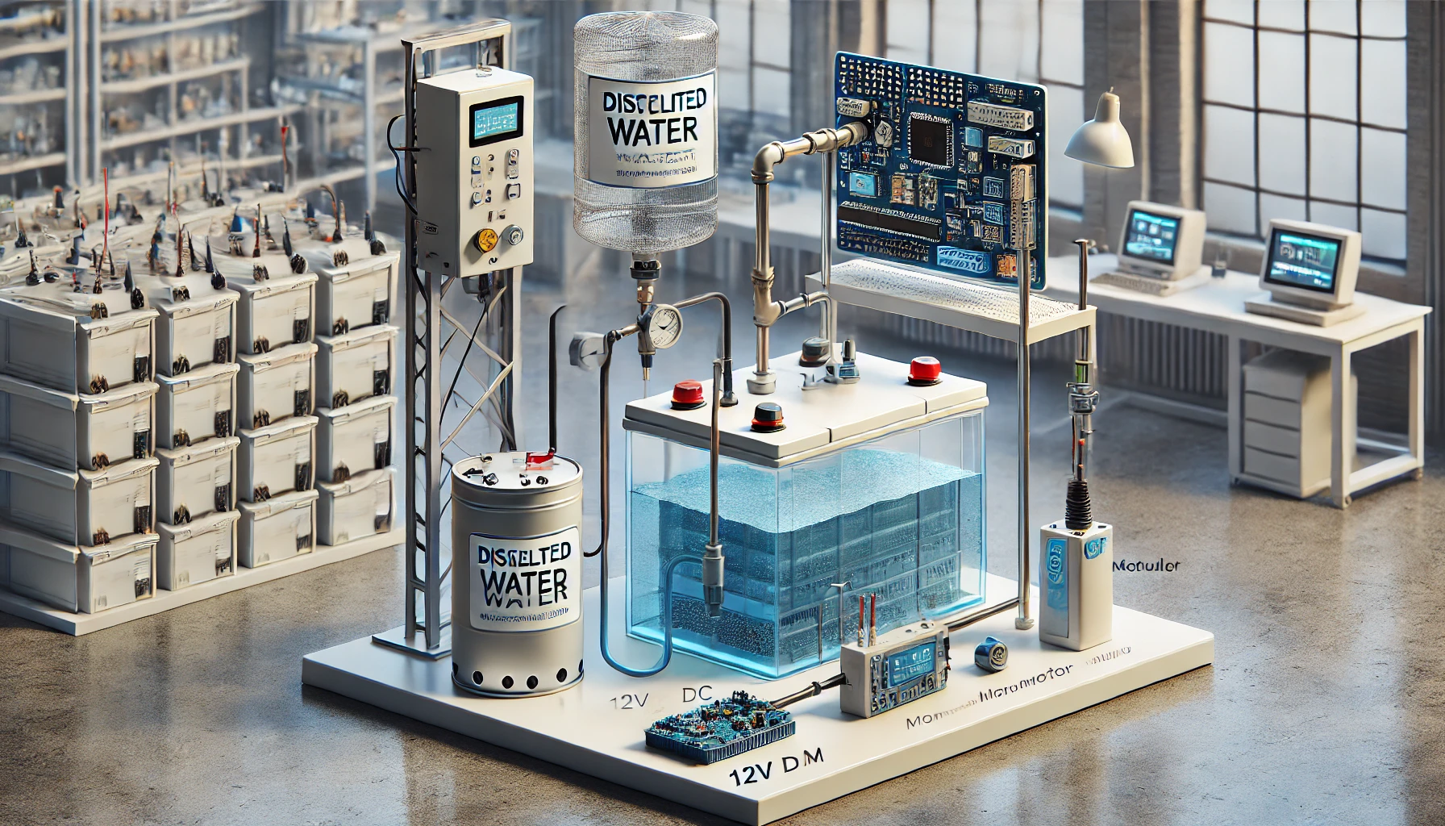
PROPOSED MODEL
The proposed model for the automatic distilled water monitoring and refilling system integrates a pressure-based depth sensor to monitor water levels in the battery and an auxiliary distilled water tank. A microcontroller processes sensor data to control a 12V DC motor-driven pump, which refills the battery when water levels drop below a predefined threshold.
The auxiliary tank is also monitored, and a GSM module sends SMS alerts to the user when it needs refilling or if any issue arises. The system is powered by a low-voltage DC source for energy efficiency and can include an optional user interface, such as an LCD or mobile app, for real-time monitoring.

Slide 8
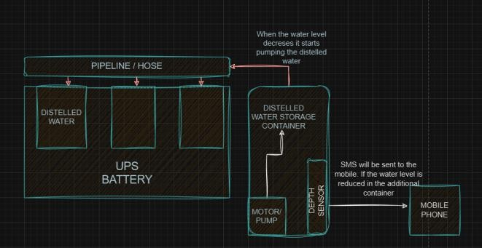
BLOCK DIAGRAM

Slide 9
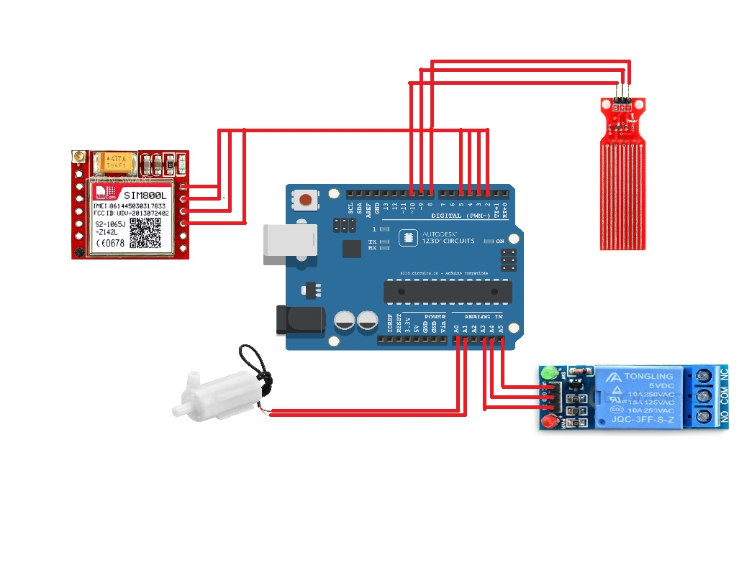
CIRCUIT DIAGRAM

Slide 10
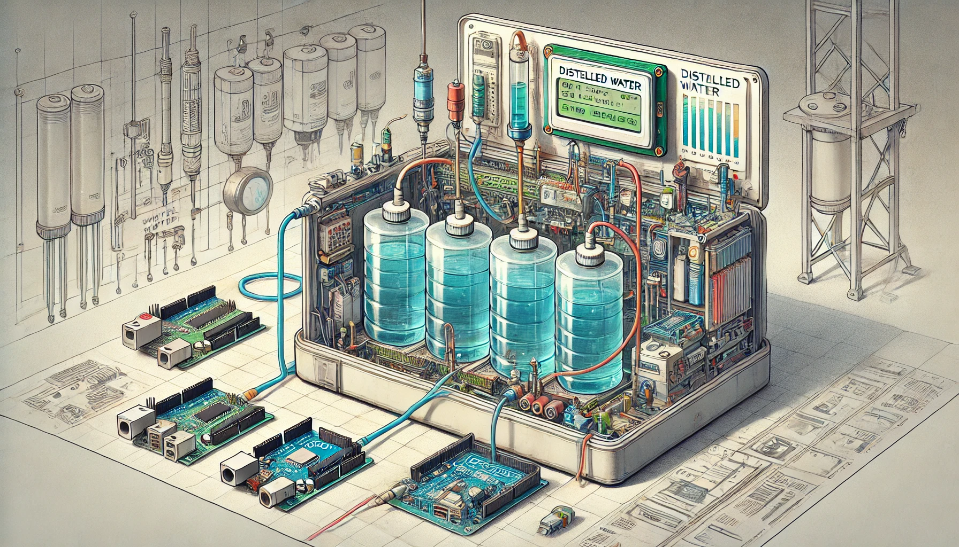
RESULT & DISSCUSSION
The Automatic Distilled Water Monitoring and Refilling System effectively automates battery water level management using a pressure-based depth sensor and a 12V DC pump. The system triggers refilling when water levels drop and sends SMS alerts via a GSM module for low levels.
It operates with low power consumption, ensuring accuracy and reliability with minimal maintenance. While it requires occasional calibration and upkeep, the system is scalable and adaptable for various applications, providing an efficient, cost-effective solution for battery maintenance. Future enhancements may include IoT integration for advanced remote monitoring.

Slide 11
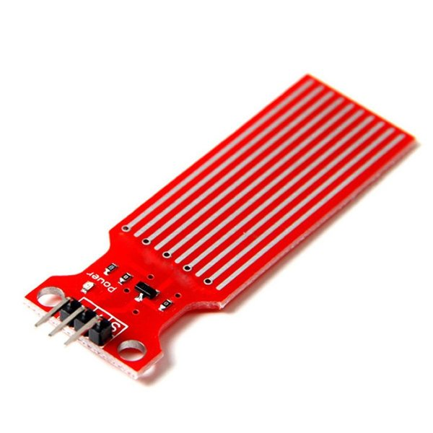
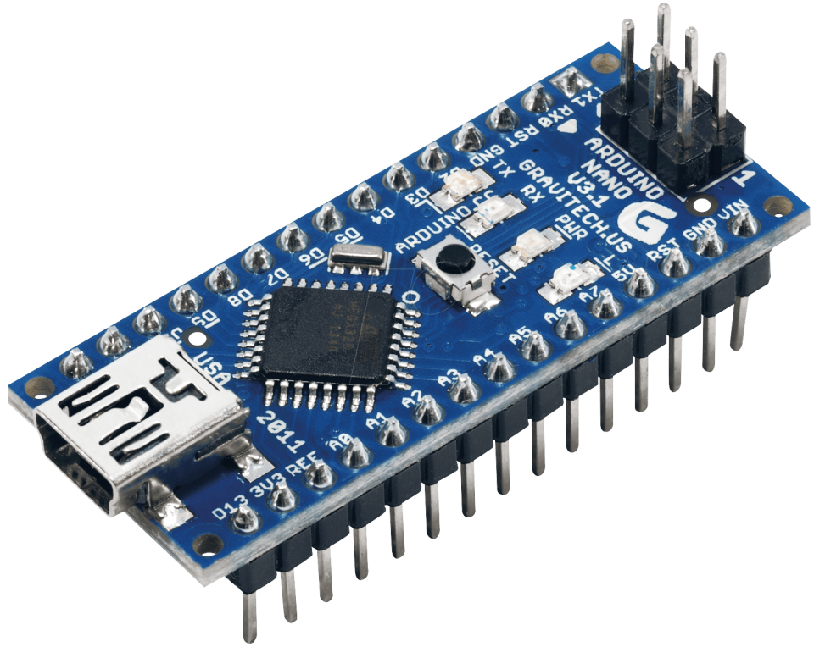
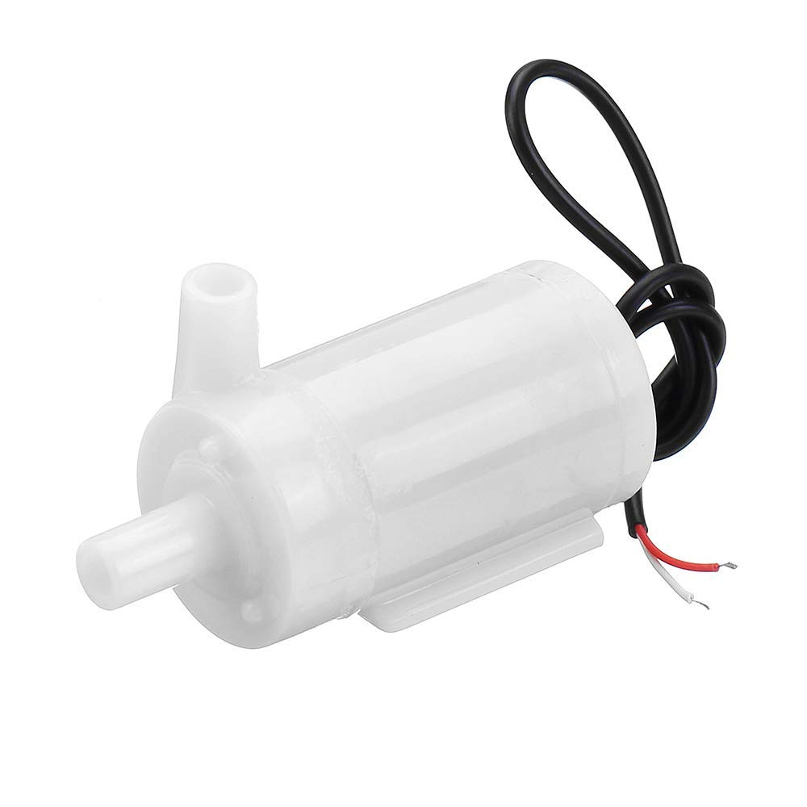
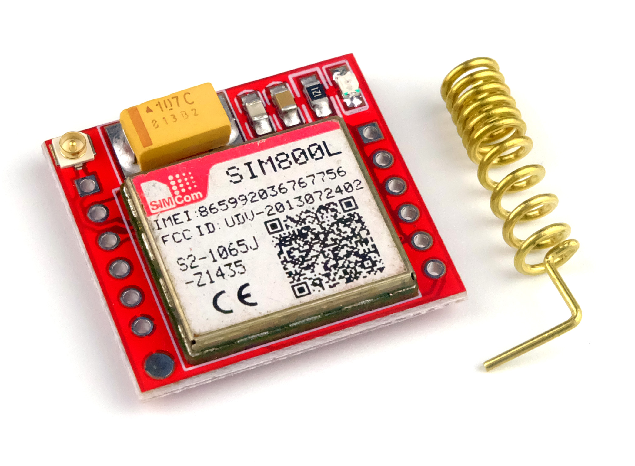
TOOLS USED
Arduino Nano
Depth Sensor
Pumping Motor(6V-9V)
SIM800L GSM Module

Slide 12
CONCLUSION
In conclusion, the Automatic Distilled Water Monitoring and Refilling System provides an efficient and automated solution for maintaining optimal water levels in batteries.
By integrating a pressure-based depth sensor, a 12V DC pump, and a GSM module for real-time alerts, the system reduces manual intervention, minimizes human error, and improves operational efficiency.
Its low power consumption, scalability, and adaptability make it suitable for various applications, including industrial, laboratory, and domestic use.
This project offers a reliable and cost-effective solution for battery maintenance, ensuring better battery health and long-term savings.

Slide 13
ADVANTEAGES
Automation and Accuracy: The system automates the refilling process, reducing human error and ensuring precise water level monitoring for optimal battery performance.
Real-Time Monitoring and Alerts: Integrated with a GSM module, it sends SMS notifications for low water levels, allowing remote monitoring and timely maintenance.
Energy Efficiency: Designed with low power consumption, the system ensures continuous operation without excessive energy usage.
Scalable and Customizable: The system is adaptable to different battery sizes and applications, making it suitable for industrial, laboratory, and domestic environments.

Slide 14
APPLICATIONS
Industrial Battery Maintenance: Ensures consistent water levels in large batteries used in industries, extending battery life and optimizing performance in systems like UPS or renewable energy storage.
Telecommunication Towers: Automates battery water refilling for remote telecommunication stations, reducing the need for manual checks and ensuring reliable backup power.
Solar Energy Systems: Maintains proper water levels in batteries for solar energy storage, improving efficiency and reducing maintenance in off-grid solar installations.
Laboratories and Research Facilities: Helps maintain battery water levels in lab equipment or backup power systems, minimizing human error and ensuring reliability.
Electric Vehicles: Automates water refilling in vehicle batteries, enhancing performance and prolonging battery lifespan.

Slide 15
REFERENCE
The role of distilled water in maintaining lead-acid battery efficiency, preventing sulfation, and extending battery life in UPS systems: (GZ Industrial Review Forum)ps://gz-ind.com/inverter-battery-efficiency-using-distilled-water/).
Research into saltwater battery technology as an alternative to lithium-ion, particular​(Energy News) storage, and its environmental benefits: UPS Battery Center.
A systematic review on IoT-based water monitoring systems provides insights into the latest developments in real-time water quality and level monitoring using sensors and IoT frameworks​(MDPI).
Another paper discusses the use of ultrasonic sensors for automated water level detection and control, highlighting their role in industrial and residential applications​(MDPI).
Research on automated water distribution systems with microcontrollers offers a foundation for building efficient, scalable water monitoring solutions​(MDPI).

Slide 16
PROJECT OUTCOME

Slide 17


